Slide 1
Inside Internet: Introduction to Internet Technologies
Rajat Rai
Lecture 01
therajatraiofficial@gmail.com

Slide 2
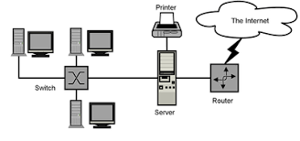
What is an INTER-NET ?
'COMPUTER NETWORK’ means a collection of autonomous computers interconnected by a single technology.
The Internet (or internet) is the global system of interconnected computer networks that uses the Internet protocol suite (TCP/IP) to communicate between networks and devices. It is a network of networks.
The term internetworking is a combination of the components inter (between) and networking. An earlier term for an internetwork is catenet, a short-form of (con)catenating networks.

Slide 3
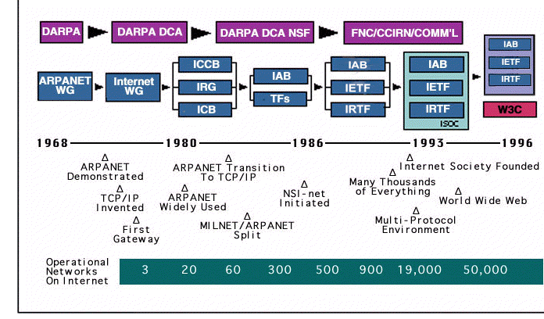
How Network became Internet ?
The first two interconnected networks were the ARPANET and the NPL network via Peter Kirstein's group at University College London.
The network elements used to connect individual networks in the ARPANET, the predecessor of the Internet, were originally called gateways, but the term has been deprecated in this context, because of possible confusion with functionally different devices.
Today the interconnecting gateways are called routers. The definition of an internetwork today includes the connection of other types of computer networks such as personal area networks.

Slide 4
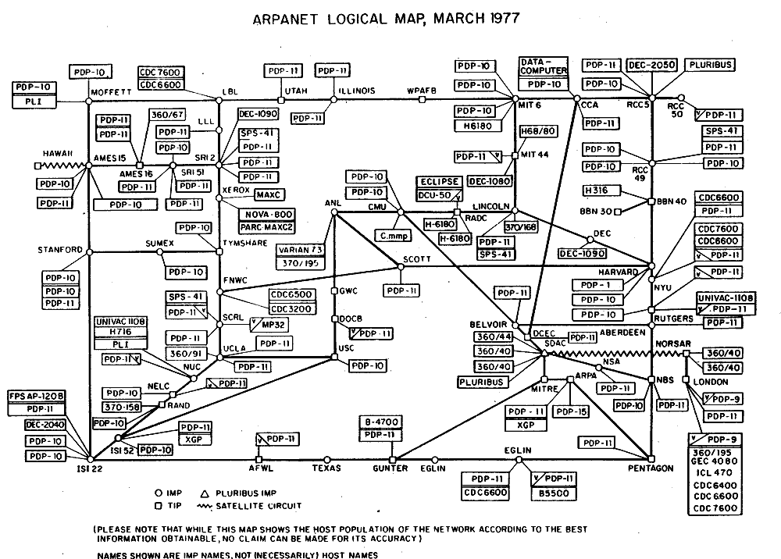
The ARPANET Saga….
The Advanced Research Projects Agency Network (ARPANET) was the first wide-area packet-switched network with distributed control and one of the first networks to implement the TCP/IP protocol suite.
Both technologies became the technical foundation of the Internet. The ARPANET was established by the Advanced Research Projects Agency (ARPA) of the United States Department of Defense.[1]

Slide 5
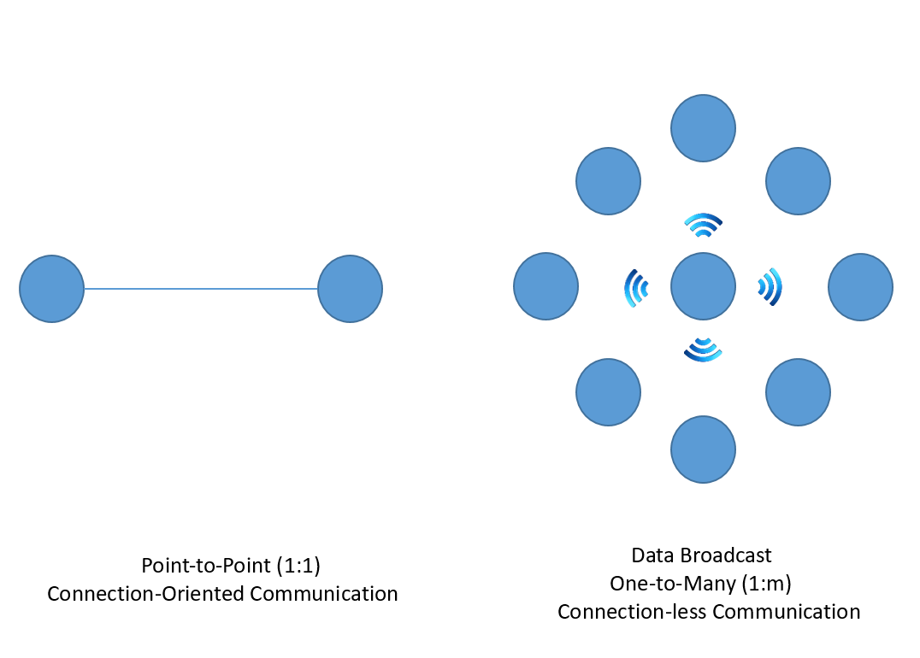
Network Classification
All computer networks fit into one of the two dimensions namely
Transmission Technology
Scale
There are two types of transmission technology
Broadcast links.
Point-to-point links

Slide 6
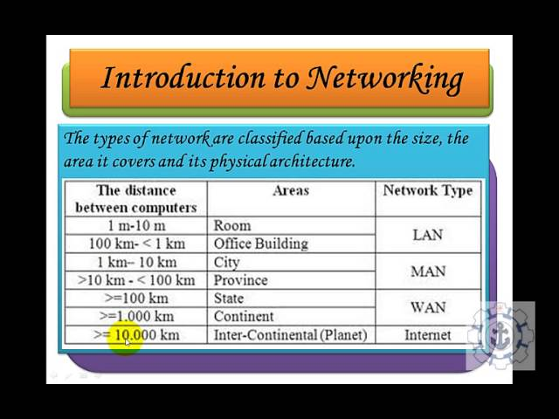
Classification of interconnected processors by scale (physical size)
Depending upon the geographical area covered by a network, it is classified as:
Local Area Network (LAN)
Metropolitan Area Network (MAN)
Wide Area Network (WAN)
Personal Area Network (PAN)

Slide 7
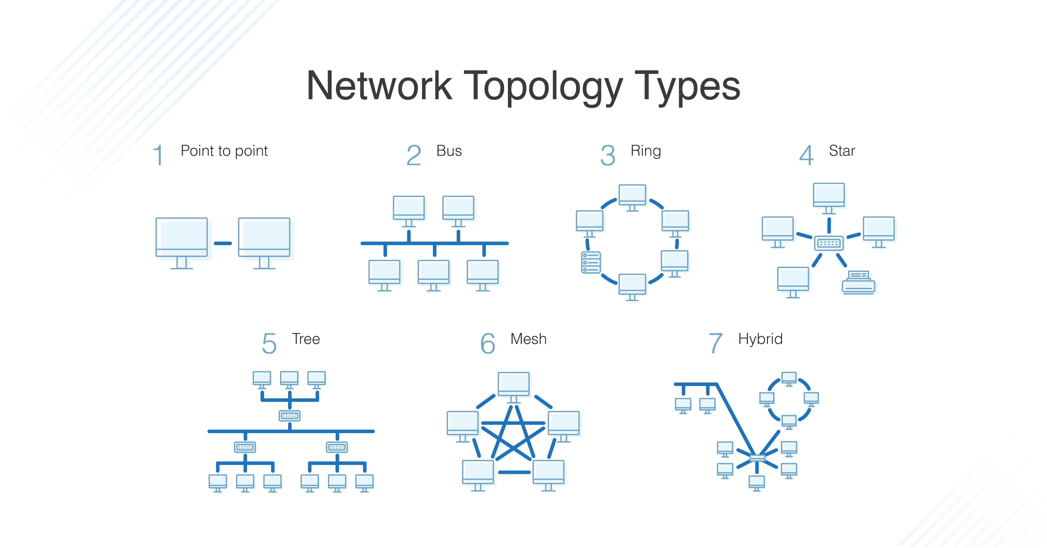
Topologies

Slide 8
Local Area Networks ( LAN )
Local area networks, generally called LANs, are privately-owned networks within a single building or campus of up to a few kilometers in size.
LANs are distinguished from other kinds of networks by three characteristics:
Their size,
Their transmission technology
Their topology.
• LANs are restricted in size
• LANs may use a transmission technology consisting of a cable to which all the machines are attached which runs at speeds of 10 Mbps to 100Mbps

Slide 9
Wireless LAN (WLAN)
A wireless local-area network (WLAN) is a group of co-located computers or other devices that form a network based on radio transmissions rather than wired connections.
A Wi-Fi network is a type of WLAN; anyone connected to Wi-Fi while reading this webpage is using a WLAN.
Is a WLAN secure?
A WLAN is more vulnerable to being breached than a physical network. With a wired network, a bad actor must gain physical access to an internal network or breach an external firewall. To access a WLAN, a bad actor must simply be within range of the network.

Slide 10
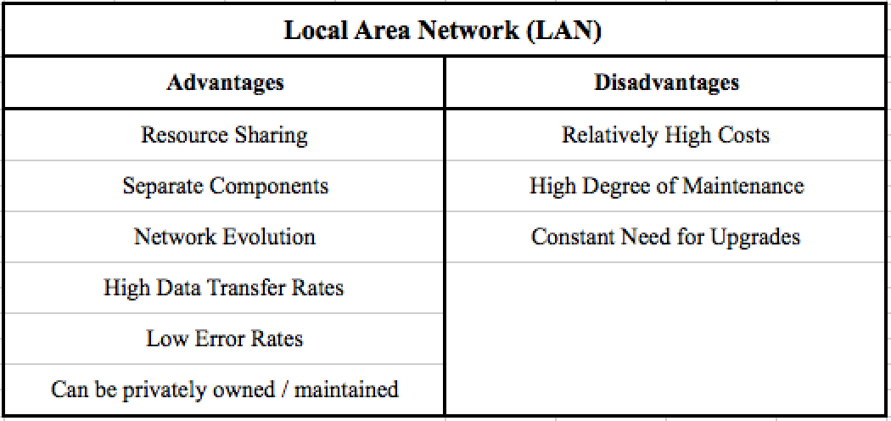
Pros & Cons of LAN

Slide 11
Assignment 01 ( Deadline : 11:59 PM - 15 April 2022 ) therajatraiofficial@gmail.com
What is an IP Address ?
What is “ping” command in cmd ?
Perform a ping test on an IP Address / any URL.
Use the command prompt.
Search for “cmd” (without the quotes) using Windows search
In the resulting pop-up box, type “ipconfig” (no quote marks) to find the information.
“ping” your IP address.
Title
Name
Content Body
Screen shots ( if any )
References

Slide 12
Inside Internet: Introduction to Internet Technologies
Rajat Rai
Lecture 02
therajatraiofficial@gmail.com

Slide 13
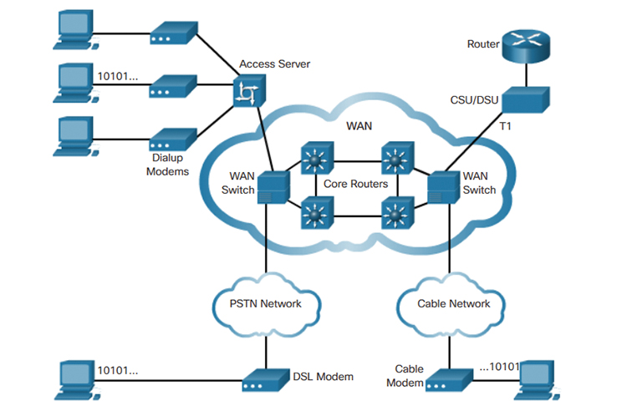
Wide Area Networks (WAN)
When network spans over a large distance or when the computers to be connected to each other are at widely separated locations a local area network cannot be used. A wide area network(WAN) is installed.
The communication between different users of WAN is established using leased telephone lines, satellite links and similar channels.

Slide 14
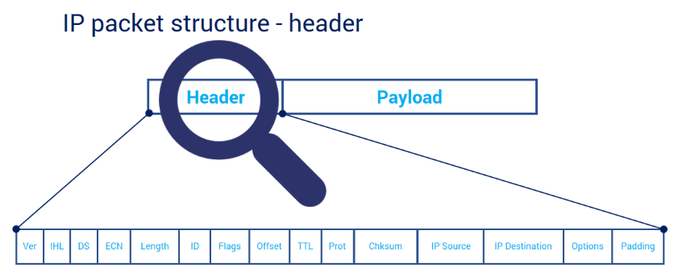
The Concept of Packet
A packet is a bit of data that is packaged for transmission over a packet switched network. It is a small amount of data sent over a network, such as a LAN or the Internet.
A typical packet includes two sections, a header and payload. The header store information about the packet while the payload section of a packet contains the actual data being transferred.

Slide 15
Packet Switched Network (PSN)
A packet switched network (PSN) is a type of computer communications network that groups and sends data in the form of small packets. It enables the sending of data or network packets between a source and destination node over a network channel that is shared between multiple users and/or applications.
A packet switched is also known as a connectionless network, as it does not create a permanent connection between a source and destination node.
Packet switching allows senders to send to multiple recipients concurrently, and allows receivers to receive from multiple senders concurrently.

Slide 16
The Transmission Control Protocol
TCP stands for Transmission Control Protocol a communications standard that enables application programs and computing devices to exchange messages over a network. It is designed to send packets across the internet and ensure the successful delivery of data and messages over networks.
TCP organizes data so that it can be transmitted between a server and a client. It guarantees the integrity of the data being communicated over a network. Before it transmits data, TCP establishes a connection between a source and its destination, which it ensures remains live until communication begins. It then breaks large amounts of data into smaller packets, while ensuring data integrity is in place throughout the process.

Slide 17
The Internet Protocol
The Internet Protocol (IP) is the method for sending data from one device to another across the internet. Every device has an IP address that uniquely identifies it and enables it to communicate with and exchange data with other devices connected to the internet.
IP is responsible for defining how applications and devices exchange packets of data with each other. It is the principal communications protocol responsible for the formats and rules for exchanging data and messages between computers on a single network or several internet-connected networks

Slide 18
What’s the Difference ?
TCP and IP are separate protocols that work together to ensure data is delivered to its intended destination within a network. IP obtains and defines the address—the IP address—of the application or device the data must be sent to. TCP is then responsible for transporting and routing data through the network architecture and ensuring it gets delivered to the destination application or device that IP has defined.
n other words, the IP address is akin to a phone number assigned to a smartphone. TCP is the computer networking version of the technology used to make the smartphone ring and enable its user to talk to the person who called them. The two protocols are frequently used together and rely on each other for data to have a destination and safely reach it, which is why the process is regularly referred to as TCP/IP.

Slide 19
Hub, Switch and Router: What are they ?
A Hub is a multiport repeater in which a signal introduced at the input of any port appears at the output of the all available ports.
Switch is a point to point communication device. A Switch is a tele-communication device which receives a message from any device connected to it and then transmits the message only to the device for which the message is intended.
A router reads the header of incoming packet and forward it to the port for which it is intended there by determines the route. It can also perform filtering and encapsulation.

Slide 20
Client Vs Server
A client and server networking model is a model in which computers such as servers provide the network services to the other computers such as clients to perform a user based tasks. This model is known as client-server networking model.
A client is a program that runs on the local machine requesting service from the server. A client program is a finite program means that the service started by the user and terminates when the service is completed.
A server is a program that runs on the remote machine providing services to the clients. When the client requests for a service, then the server opens the door for the incoming requests, but it never initiates the service.
server farm or server cluster is a collection of computer servers – usually maintained by an organization to supply server functionality far beyond the capability of a single machine. Server farms often consist of thousands of computers which require a large amount of power to run and to keep cool. At the optimum performance level, a server farm has enormous costs (both financial and environmental) associated with it.

Slide 21
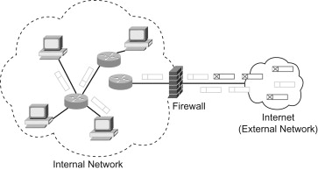
Network Security
Network security is a broad term that covers a multitude of technologies, devices and processes. In its simplest term, it is a set of rules and configurations designed to protect the integrity, confidentiality and accessibility of computer networks and data using both software and hardware technologies.
Firewalls, as their name suggests, act as a barrier between the untrusted external networks and your trusted internal network. Administrators typically configure a set of defined rules that blocks or permits traffic onto the network.

Slide 22
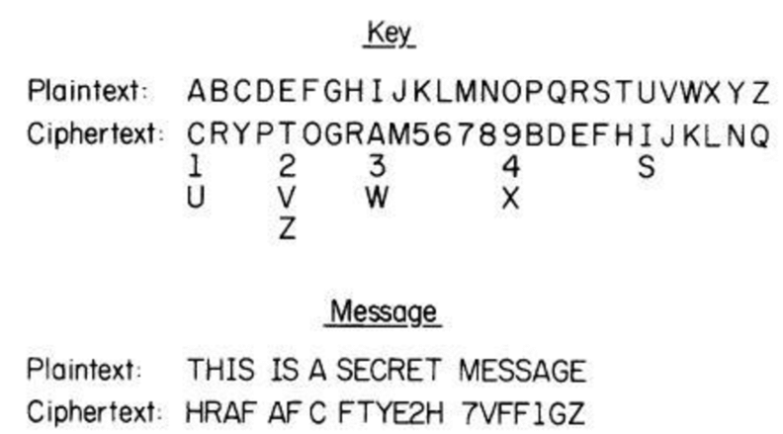
Data Security
Data security refers to the process of protecting data from unauthorized access and data corruption throughout its lifecycle. Data security includes data encryption, hashing, tokenization, and key management practices that protect data across all applications and platforms.

Slide 23
Assignment 02
Deadline : 16 April 11:59 PM therajatraiofficial@gmail.com
Caesar Cipher
The Caesar cipher shifts all the letters in a piece of text by a certain number of places. The key for this cipher is a letter which represents the number of place for the shift. So, for example, a key D means “shift 3 places” and a key M means “shift 12 places”. Note that a key A means “do not shift” and a key Z can either mean “shift 25 places” or “shift one place backwards”. For example, the word “CAESAR” with a shift P becomes “RPTHPG”.
Example :
Text : ATTACKATONCE
Shift: 4
Cipher: EXXEGOEXSRGI

Slide 24
Assignment 02
Deadline : 16 April 11:59 PM therajatraiofficial@gmail.com
Question 1
(a) What does “CAESAR” become with a shift of F?
(b) What key do we need to make “CAESAR” become “MKOCKB”?
(c) What key do we need to make “CIPHER” become “SYFXUH”?
(d) Use the Caesar cipher to encrypt your first name
Quiz on 16 April 2022 at 6:00PM

